Slide 1
Stars and bars

Slide 2
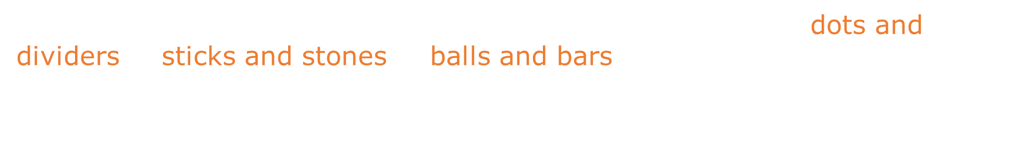
Stars and bars
The combinatorial principle, known under different names ("dots and
dividers", "sticks and stones", "balls and bars") allows us to solve many
counting problems, such as determining in how many ways we can place $n$
indistinguishable balls into $k$ distinguishable boxes.

Slide 3
Stars and bars
The combinatorial principle, known under different names ("dots and
dividers", "sticks and stones", "balls and bars") allows us to solve many
counting problems, such as determining in how many ways we can place $n$
indistinguishable balls into $k$ distinguishable boxes.
We introduce this principle, following Wikipedia, with two examples.

Slide 4
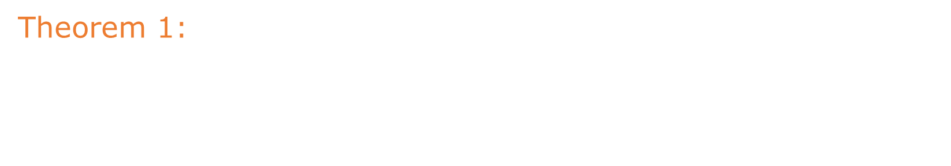
Stars and bars
Theorem 1:
For any two natural numbers $n$ and $k$, the number of $k$-tuples
(ordered sequences) of natural numbers ($≥1$), whose sum is $n$
equals $\left({n−1 \atop k−1}\right)$.

Slide 5
Stars and bars
Theorem 1:
For any two natural numbers $n$ and $k$, the number of $k$-tuples
(ordered sequences) of natural numbers ($≥1$), whose sum is $n$
equals $\left({n−1 \atop k−1}\right)$.
Example:

Slide 6
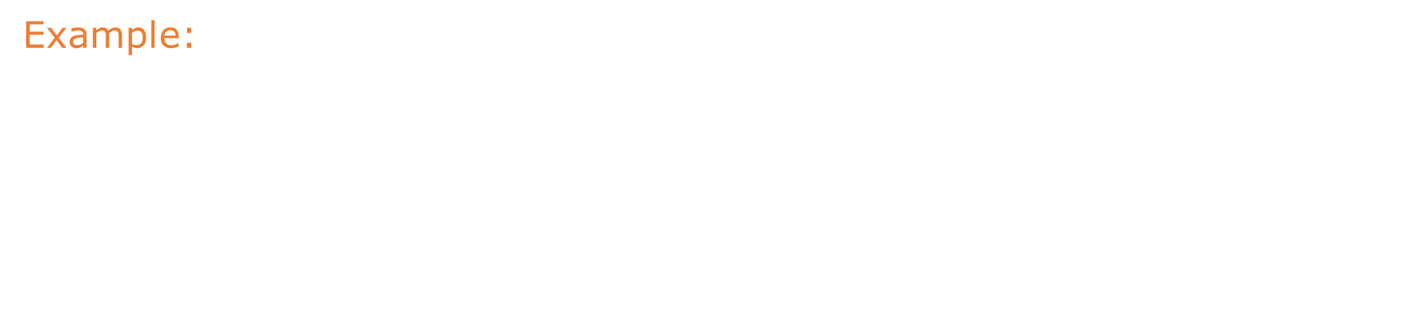
Stars and bars
Theorem 1:
For any two natural numbers $n$ and $k$, the number of $k$-tuples
(ordered sequences) of natural numbers ($≥1$), whose sum is $n$
equals $\left({n−1 \atop k−1}\right)$.
Example:
For $n=10$ and $k=4$, this theorem gives the number of solutions to
the equation
$$x_{1}+x_{2}+x_{3}+x_{4}=10$$
(where $x_{1},x_{2},x_{3},x_{4}≥1$ – all natural numbers) as:
$$\left({n−1 \atop k−1}\right)=\left({10−1 \atop 4−1}\right)$$

Slide 7
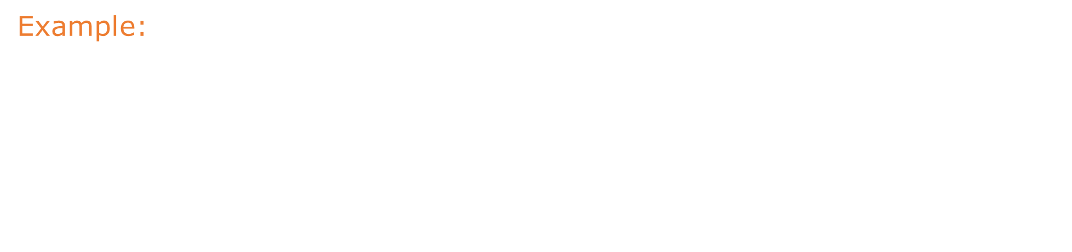
Stars and bars
Theorem 1:
For any two natural numbers $n$ and $k$, the number of $k$-tuples
(ordered sequences) of natural numbers ($≥1$), whose sum is $n$
equals $\left({n−1 \atop k−1}\right)$.
Example:
For $n=10$ and $k=4$, this theorem gives the number of solutions to
the equation
$$x_{1}+x_{2}+x_{3}+x_{4}=10$$
(where $x_{1},x_{2},x_{3},x_{4}≥1$ – all natural numbers) as:
$$\left({n−1 \atop k−1}\right)=\left({10−1 \atop 4−1}\right)=\left({9 \atop 3}\right)=84$$

Slide 8
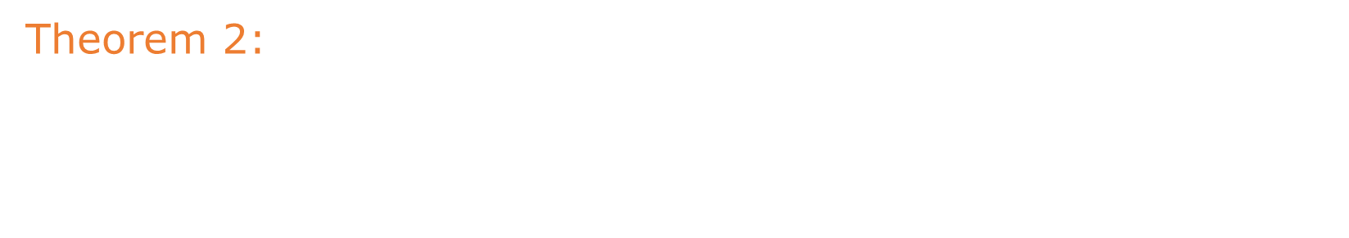
Stars and bars
Theorem 2:
For any two natural numbers $n$ and $k$, the number of $k$-tuples
(ordered sequences) of natural numbers ($≥0$), whose sum is $n$
equals $\left({k+n−1 \atop n}\right)$.

Slide 9
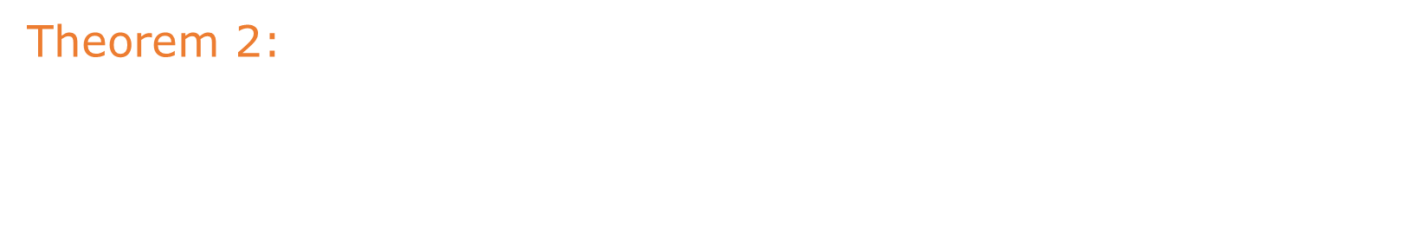
Stars and bars
Theorem 2:
For any two natural numbers $n$ and $k$, the number of $k$-tuples
(ordered sequences) of natural numbers ($≥0$), whose sum is $n$
equals $\left({k+n−1 \atop n}\right)=\left({k+n−1 \atop k−1}\right)$.

Slide 10
Stars and bars
Theorem 2:
For any two natural numbers $n$ and $k$, the number of $k$-tuples
(ordered sequences) of natural numbers ($≥0$), whose sum is $n$
equals $\left({k+n−1 \atop n}\right)=\left({k+n−1 \atop k−1}\right)$.
Example:

Slide 11
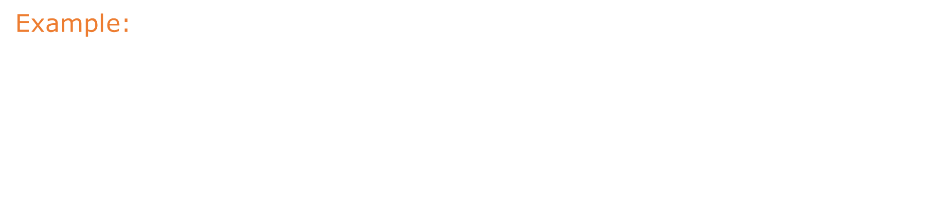
Stars and bars
Theorem 2:
For any two natural numbers $n$ and $k$, the number of $k$-tuples
(ordered sequences) of natural numbers ($≥0$), whose sum is $n$
equals $\left({k+n−1 \atop n}\right)=\left({k+n−1 \atop k−1}\right)$.
Example:
For $n=10$ and $k=4$ this theorem gives the number of solutions to the
equation
$$x_{1}+x_{2}+x_{3}+x_{4}=10$$
(where $x_{1},x_{2},x_{3},x_{4}≥0$ – natural numbers) as:
$$\left({k+n−1 \atop n}\right)=\left({10+4−1 \atop 10}\right)$$

Slide 12
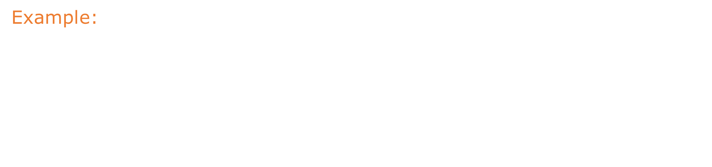
Stars and bars
Theorem 2:
For any two natural numbers $n$ and $k$, the number of $k$-tuples
(ordered sequences) of natural numbers ($≥0$), whose sum is $n$
equals $\left({k+n−1 \atop n}\right)=\left({k+n−1 \atop k−1}\right)$.
Example:
For $n=10$ and $k=4$ this theorem gives the number of solutions to the
equation
$$x_{1}+x_{2}+x_{3}+x_{4}=10$$
(where $x_{1},x_{2},x_{3},x_{4}≥0$ – natural numbers) as:
$$\left({k+n−1 \atop n}\right)=\left({10+4−1 \atop 10}\right)=\left({13 \atop 10}\right)=286$$

Slide 13
Stars and bars
Theorem 1:
For any two natural numbers $n$ and $k$, the number of $k$-tuples
(ordered sequences) of natural numbers ($≥1$), whose sum is $n$
equals $\left({n−1 \atop k−1}\right)$.
Proof:

Slide 14

Stars and bars
Theorem 1:
For any two natural numbers $n$ and $k$, the number of $k$-tuples
(ordered sequences) of natural numbers ($≥1$), whose sum is $n$
equals $\left({n−1 \atop k−1}\right)$.
Proof:
Assume there are $n$ objects (represented here by •), which we place
into $k$ containers. The containers are distinguishable (e.g., colored),
but the dots are not.

Slide 15

Stars and bars
Theorem 1:
For any two natural numbers $n$ and $k$, the number of $k$-tuples
(ordered sequences) of natural numbers ($≥1$), whose sum is $n$
equals $\left({n−1 \atop k−1}\right)$.
Proof:
Assume there are $n$ objects (represented here by •), which we place
into $k$ containers. The containers are distinguishable (e.g., colored),
but the dots are not. Configurations are therefore distinguishable only
by the number of dots (balls) in each container.

Slide 16

Stars and bars
Theorem 1:
For any two natural numbers $n$ and $k$, the number of $k$-tuples
(ordered sequences) of natural numbers ($≥1$), whose sum is $n$
equals $\left({n−1 \atop k−1}\right)$.
Proof:
Assume there are $n$ objects (represented here by •), which we place
into $k$ containers. The containers are distinguishable (e.g., colored),
but the dots are not. Configurations are therefore distinguishable only
by the number of dots (balls) in each container. Each such configuration
can be represented by dots and bars, where a bar indicates moving
to the next container.

Slide 17

Stars and bars
Theorem 1:
For any two natural numbers $n$ and $k$, the number of $k$-tuples
(ordered sequences) of natural numbers ($≥1$), whose sum is $n$
equals $\left({n−1 \atop k−1}\right)$.
Proof:
Assume there are $n$ objects (represented here by •), which we place
into $k$ containers. The containers are distinguishable (e.g., colored),
but the dots are not. Configurations are therefore distinguishable only
by the number of dots (balls) in each container. Each such configuration
can be represented by dots and bars, where a bar indicates moving
to the next container.
For example, For $n=10,k=4$ one possible arrangement is:

Slide 18

Stars and bars
Theorem 1:
For any two natural numbers $n$ and $k$, the number of $k$-tuples
(ordered sequences) of natural numbers ($≥1$), whose sum is $n$
equals $\left({n−1 \atop k−1}\right)$.
Proof:
Assume there are $n$ objects (represented here by •), which we place
into $k$ containers. The containers are distinguishable (e.g., colored),
but the dots are not. Configurations are therefore distinguishable only
by the number of dots (balls) in each container. Each such configuration
can be represented by dots and bars, where a bar indicates moving
to the next container.
For example, For $n=10,k=4$ one possible arrangement is:
• • • •│• • •│•│• •

Slide 19

Stars and bars
Assume there are $n$ objects (represented here by •), which we place
into $k$ containers. The containers are distinguishable (e.g., colored),
but the dots are not. Configurations are therefore distinguishable only
by the number of dots (balls) in each container. Each such configuration
can be represented by dots and bars, where a bar indicates moving
to the next container.
For example, For $n=10,k=4$ one possible arrangement is:
• • • •│• • •│•│• •

Slide 20
Stars and bars
Assume there are $n$ objects (represented here by •), which we place
into $k$ containers. The containers are distinguishable (e.g., colored),
but the dots are not. Configurations are therefore distinguishable only
by the number of dots (balls) in each container. Each such configuration
can be represented by dots and bars, where a bar indicates moving
to the next container.
For example, For $n=10,k=4$ one possible arrangement is:
• • • •│• • •│•│• •
No container can be empty, so there can be at most one bar between
a pair of dots.

Slide 21

Stars and bars
Assume there are $n$ objects (represented here by •), which we place
into $k$ containers. The containers are distinguishable (e.g., colored),
but the dots are not. Configurations are therefore distinguishable only
by the number of dots (balls) in each container. Each such configuration
can be represented by dots and bars, where a bar indicates moving
to the next container.
For example, For $n=10,k=4$ one possible arrangement is:
• • • •│• • •│•│• •
No container can be empty, so there can be at most one bar between
a pair of dots. Dots and bars uniquely define the numbers $x_{1},x_{2},x_{3},x_{4}$
such that $x_{1}+x_{2}+x_{3}+x_{4}=10$.

Slide 22
Stars and bars
Assume there are $n$ objects (represented here by •), which we place
into $k$ containers. The containers are distinguishable (e.g., colored),
but the dots are not. Configurations are therefore distinguishable only
by the number of dots (balls) in each container. Each such configuration
can be represented by dots and bars, where a bar indicates moving
to the next container.
For example, For $n=10,k=4$ one possible arrangement is:
• • • •│• • •│•│• •
No container can be empty, so there can be at most one bar between
a pair of dots. Dots and bars uniquely define the numbers $x_{1},x_{2},x_{3},x_{4}$
such that $x_{1}+x_{2}+x_{3}+x_{4}=10$.
There are $n−1$ spaces between the dots (possible places for bars).

Slide 23
Stars and bars
Assume there are $n$ objects (represented here by •), which we place
into $k$ containers. The containers are distinguishable (e.g., colored),
but the dots are not. Configurations are therefore distinguishable only
by the number of dots (balls) in each container. Each such configuration
can be represented by dots and bars, where a bar indicates moving
to the next container.
For example, For $n=10,k=4$ one possible arrangement is:
• • • •│• • •│•│• •
No container can be empty, so there can be at most one bar between
a pair of dots. Dots and bars uniquely define the numbers $x_{1},x_{2},x_{3},x_{4}$
such that $x_{1}+x_{2}+x_{3}+x_{4}=10$.
There are $n−1$ spaces between the dots (possible places for bars).
The configuration is determined by the placement of $k−1$ bars.

Slide 24

Stars and bars
Assume there are $n$ objects (represented here by •), which we place
into $k$ containers. The containers are distinguishable (e.g., colored),
but the dots are not. Configurations are therefore distinguishable only
by the number of dots (balls) in each container. Each such configuration
can be represented by dots and bars, where a bar indicates moving
to the next container.
For example, For $n=10,k=4$ one possible arrangement is:
• • • •│• • •│•│• •
No container can be empty, so there can be at most one bar between
a pair of dots. Dots and bars uniquely define the numbers $x_{1},x_{2},x_{3},x_{4}$
such that $x_{1}+x_{2}+x_{3}+x_{4}=10$.
There are $n−1$ spaces between the dots (possible places for bars).
The configuration is determined by the placement of $k−1$ bars.
The order of placing the bars does not matter.

Slide 25

Stars and bars
Assume there are $n$ objects (represented here by •), which we place
into $k$ containers. The containers are distinguishable (e.g., colored),
but the dots are not. Configurations are therefore distinguishable only
by the number of dots (balls) in each container. Each such configuration
can be represented by dots and bars, where a bar indicates moving
to the next container.
For example, For $n=10,k=4$ one possible arrangement is:
• • • •│• • •│•│• •
No container can be empty, so there can be at most one bar between
a pair of dots. Dots and bars uniquely define the numbers $x_{1},x_{2},x_{3},x_{4}$
such that $x_{1}+x_{2}+x_{3}+x_{4}=10$.
There are $n−1$ spaces between the dots (possible places for bars).
The configuration is determined by the placement of $k−1$ bars.
The order of placing the bars does not matter. Thus we have combinations
of choosing $k−1$ bars out of $n−1$ positions.

Slide 26

Stars and bars
Assume there are $n$ objects (represented here by •), which we place
into $k$ containers. The containers are distinguishable (e.g., colored),
but the dots are not. Configurations are therefore distinguishable only
by the number of dots (balls) in each container. Each such configuration
can be represented by dots and bars, where a bar indicates moving
to the next container.
For example, For $n=10,k=4$ one possible arrangement is:
• • • •│• • •│•│• •
No container can be empty, so there can be at most one bar between
a pair of dots. Dots and bars uniquely define the numbers $x_{1},x_{2},x_{3},x_{4}$
such that $x_{1}+x_{2}+x_{3}+x_{4}=10$.
There are $n−1$ spaces between the dots (possible places for bars).
The configuration is determined by the placement of $k−1$ bars.
The order of placing the bars does not matter. Thus we have combinations
of choosing $k−1$ bars out of $n−1$ positions. Therefore indeed: $\left({n−1 \atop k−1}\right)$.

Slide 27
Stars and bars
Theorem 2:
For any two natural numbers $n$ and $k$, the number of $k$-tuples
(ordered sequences) of natural numbers ($≥0$), whose sum is $n$
equals $\left({k+n−1 \atop n}\right)=\left({k+n−1 \atop k−1}\right)$.
Proof:

Slide 28
Stars and bars
Theorem 2:
For any two natural numbers $n$ and $k$, the number of $k$-tuples
(ordered sequences) of natural numbers ($≥0$), whose sum is $n$
equals $\left({k+n−1 \atop n}\right)=\left({k+n−1 \atop k−1}\right)$.
Proof:
In this case, weakening the condition to nonnegative integers
means that containers may be empty. Therefore, several bars can be
placed next to each other.

Slide 29
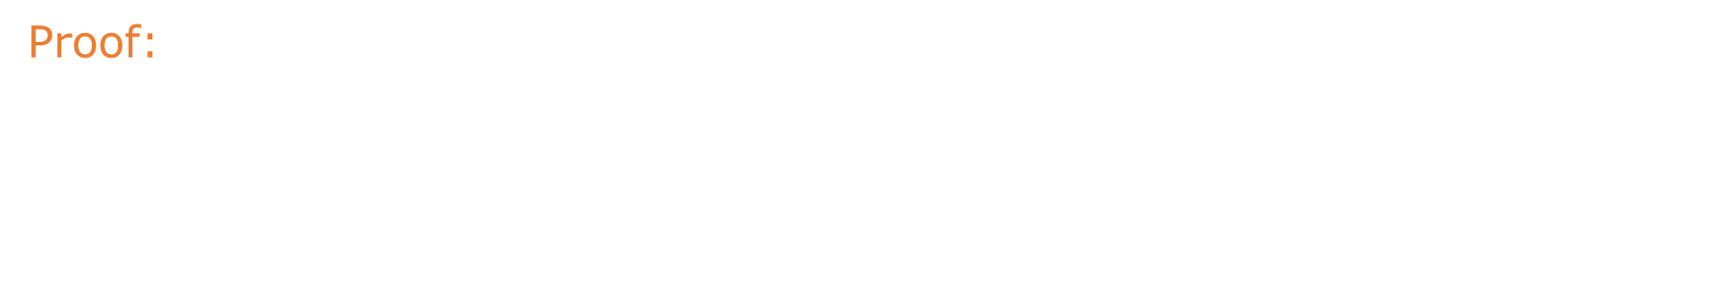
Stars and bars
Theorem 2:
For any two natural numbers $n$ and $k$, the number of $k$-tuples
(ordered sequences) of natural numbers ($≥0$), whose sum is $n$
equals $\left({k+n−1 \atop n}\right)=\left({k+n−1 \atop k−1}\right)$.
Proof:
In this case, weakening the condition to nonnegative integers
means that containers may be empty. Therefore, several bars can be
placed next to each other. For example, for $n=10,k=4$ the tuple $\left(4,0,3,3\right)$
can be represented as:

Slide 30
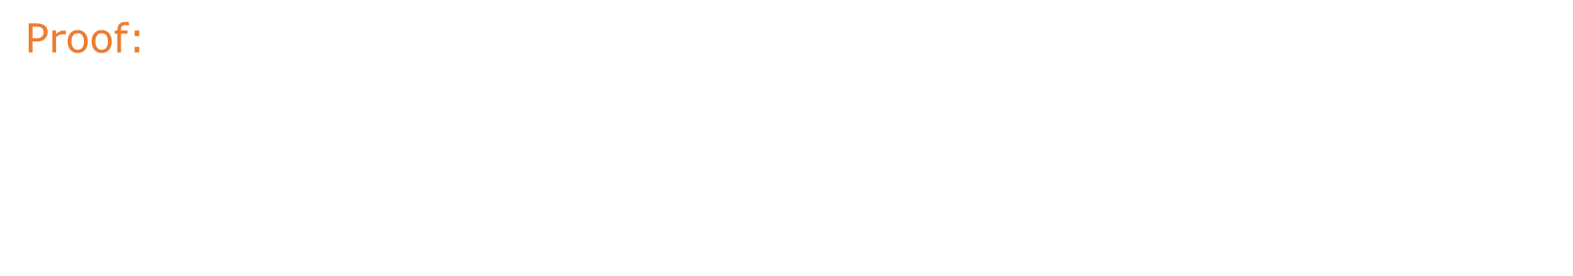
Stars and bars
Theorem 2:
For any two natural numbers $n$ and $k$, the number of $k$-tuples
(ordered sequences) of natural numbers ($≥0$), whose sum is $n$
equals $\left({k+n−1 \atop n}\right)=\left({k+n−1 \atop k−1}\right)$.
Proof:
In this case, weakening the condition to nonnegative integers
means that containers may be empty. Therefore, several bars can be
placed next to each other. For example, for $n=10,k=4$ the tuple $\left(4,0,3,3\right)$
can be represented as: • • • •││• • •│• • •

Slide 31
Stars and bars
Theorem 2:
For any two natural numbers $n$ and $k$, the number of $k$-tuples
(ordered sequences) of natural numbers ($≥0$), whose sum is $n$
equals $\left({k+n−1 \atop n}\right)=\left({k+n−1 \atop k−1}\right)$.
Proof:
In this case, weakening the condition to nonnegative integers
means that containers may be empty. Therefore, several bars can be
placed next to each other. For example, for $n=10,k=4$ the tuple $\left(4,0,3,3\right)$
can be represented as: • • • •││• • •│• • •
Note that each configuration contains $n+k−1$ symbols (dots and bars)
$n$ of them are dots, $k−1$ are bars.

Slide 32

Stars and bars
Theorem 2:
For any two natural numbers $n$ and $k$, the number of $k$-tuples
(ordered sequences) of natural numbers ($≥0$), whose sum is $n$
equals $\left({k+n−1 \atop n}\right)=\left({k+n−1 \atop k−1}\right)$.
Proof:
In this case, weakening the condition to nonnegative integers
means that containers may be empty. Therefore, several bars can be
placed next to each other. For example, for $n=10,k=4$ the tuple $\left(4,0,3,3\right)$
can be represented as: • • • •││• • •│• • •
Note that each configuration contains $n+k−1$ symbols (dots and bars)
$n$ of them are dots, $k−1$ are bars.
Thus, we only need to choose $k−1$ out of $n+k−1$ positions for the bars

Slide 33

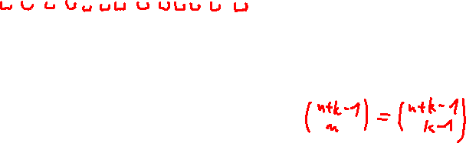
Stars and bars
Theorem 2:
For any two natural numbers $n$ and $k$, the number of $k$-tuples
(ordered sequences) of natural numbers ($≥0$), whose sum is $n$
equals $\left({k+n−1 \atop n}\right)=\left({k+n−1 \atop k−1}\right)$.
Proof:
In this case, weakening the condition to nonnegative integers
means that containers may be empty. Therefore, several bars can be
placed next to each other. For example, for $n=10,k=4$ the tuple $\left(4,0,3,3\right)$
can be represented as: • • • •││• • •│• • •
Note that each configuration contains $n+k−1$ symbols (dots and bars)
$n$ of them are dots, $k−1$ are bars.
Thus, we only need to choose $k−1$ out of $n+k−1$ positions for the bars
(equivalently: choose $n$ positions for the dots).

Slide 34
Stars and bars
From now on, we should be able to solve problems of the type:

Slide 35
Stars and bars
From now on, we should be able to solve problems of the type:
How many solutions does the equation $a+b+c=100$ have for $a,b,c∈ℕ_{+}$?

Slide 36

Stars and bars
From now on, we should be able to solve problems of the type:
How many solutions does the equation $a+b+c=100$ have for $a,b,c∈ℕ_{+}$?
How many solutions does the equation $a+b+c=100$ have for $a,b,c∈ℕ_{0}$?

Slide 37

Stars and bars
From now on, we should be able to solve problems of the type:
How many solutions does the equation $a+b+c=100$ have for $a,b,c∈ℕ_{+}$?
How many solutions does the equation $a+b+c=100$ have for $a,b,c∈ℕ_{0}$?
In how many ways can we place $7$ indistinguishable ping-pong balls
into $3$ labeled containers $A,B,C$?

Slide 38

Stars and bars
From now on, we should be able to solve problems of the type:
How many solutions does the equation $a+b+c=100$ have for $a,b,c∈ℕ_{+}$?
How many solutions does the equation $a+b+c=100$ have for $a,b,c∈ℕ_{0}$?
In how many ways can we place $7$ indistinguishable ping-pong balls
into $3$ labeled containers $A,B,C$?
In how many ways can we place $7$ indistinguishable ping-pong balls
into $3$ labeled containers $A,B,C,$ so that no container is empty?

Slide 39


Stars and bars
From now on, we should be able to solve problems of the type:
How many solutions does the equation $a+b+c=100$ have for $a,b,c∈ℕ_{+}$?
How many solutions does the equation $a+b+c=100$ have for $a,b,c∈ℕ_{0}$?
In how many ways can we place $7$ indistinguishable ping-pong balls
into $3$ labeled containers $A,B,C$?
In how many ways can we place $7$ indistinguishable ping-pong balls
into $3$ labeled containers $A,B,C,$ so that no container is empty?
But not:
In how many ways can $7$ people be placed into $5$ rooms?

Slide 40

Stars and bars
From now on, we should be able to solve problems of the type:
How many solutions does the equation $a+b+c=100$ have for $a,b,c∈ℕ_{+}$?
How many solutions does the equation $a+b+c=100$ have for $a,b,c∈ℕ_{0}$?
In how many ways can we place $7$ indistinguishable ping-pong balls
into $3$ labeled containers $A,B,C$?
In how many ways can we place $7$ indistinguishable ping-pong balls
into $3$ labeled containers $A,B,C,$ so that no container is empty?
But not:
In how many ways can $7$ people be placed into $5$ rooms?
In how many ways can $7$ people be placed into $5$ rooms,
so that no room is empty?

